Slide 1
Who is in the picture AI frameworks
Rayen Ghordo
Notes:
Good afternoon, I am Rayen Ghordo and today I will present my Face Recognition Project.

Slide 2
cONTENT
Introduction
Detection Workflow
Embedding Generation
Selection of K
Clustering
Model Training
Notes:
First I will give a quick introduction to the project. Then I will explain my workflow and motivate my choices and calculations, like embeddings generation, the selection of k, how I clustered and which models I trained.

Slide 3
Introduction
Notes:
For this project we had to train a model to recognize faces of the people in our classroom. We had to take images of everyone to create our dataset and then the dataset was divided over all students to label. This caused 2 problems for me.

Slide 4
Problem 1: inconsistency
No clear labelling rules
Partially visible or unclear faces
→ Inconsistent labels
Notes:
When I first started, I noticed that there were no clear labelling rules and some students labelled partially visible faces while some didn’t. This resulted in inconsistent labels.

Slide 5
Problem 2: overlabeling
Hundreds of faces to label
Not all faces are detectable by the model
→ Risk of labelling unusable data
Notes:
Because of this, I had to relabel hundreds of images. But I wasn’t sure which faces would be detectable by the face detection model. This could lead to labelling unusable data.

Slide 6
Strategy
Detect & align faces
Face embeddings
Clustering
→ labelled data
Training
Notes:
To solve all this, I came up with a new strategy: I would first use a face detection model to detect and align the faces in the images, then I will create embeddings of the images which I can use to make clusters. This way I only need to label the clusters instead of all faces in all images. Lastly, I can train the models.

Slide 7
Detection workflow

Slide 8
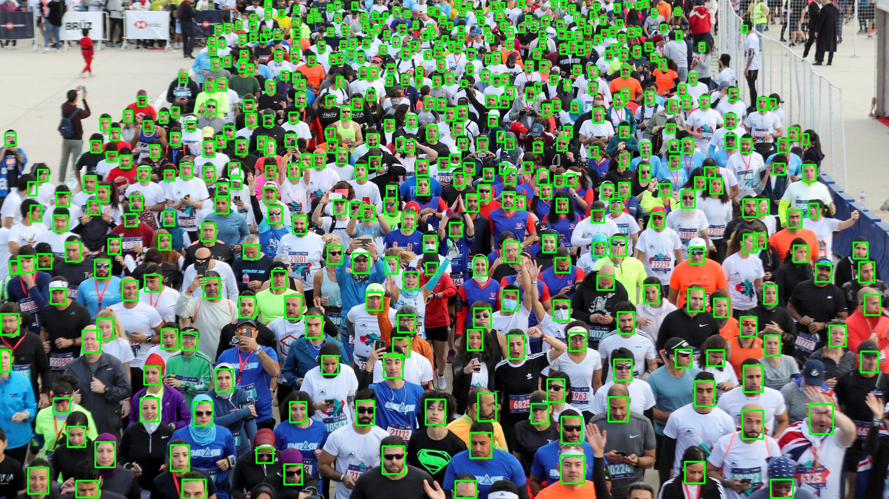
Face detection model selection
RetinaFace
Provided by UniFace
Real world conditions
Notes:
After research based on the internet and with my fellow students, I decided to go with RetinaFace. RetinaFace is a face detection model provided by the UniFace library which performs really good under real world conditions. It returns a confidence score and the landmarks which I later need.

Slide 9
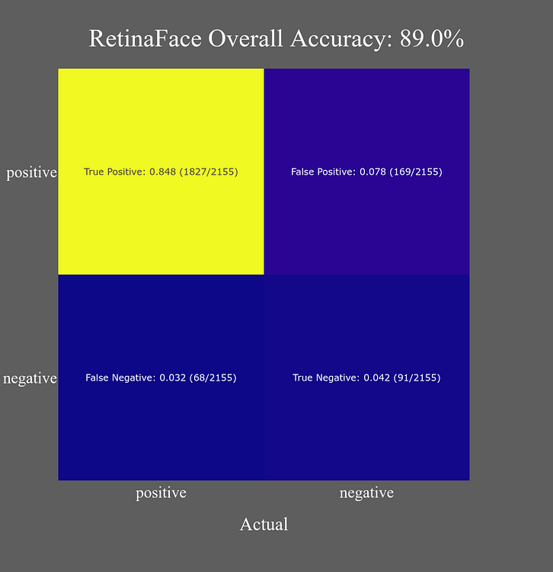
Face detection model selection
Evaluated on a dataset of 1000 samples
High number of true positives
Reliable face detection performance
Notes:
For this confusion matrix, RetinaFace has been tested on 1000 samples. As we can see, it has a high number of true positives.

Slide 10
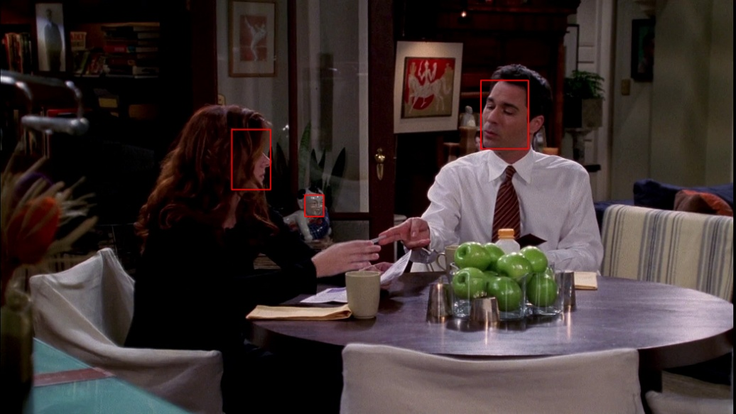
Face detection model selection
RetinaFace is highly sensitive
Can detect non-face regions as faces
Background patterns may resemble facial features
Results in false detections
Confidence threshold & filter based on bounding box size
Notes:
During testing, I found out that RetinaFace can sometimes be too good and it will actually detect faces in the background, such as facial-like patterns. This resulted in false detections. To solve this, I had to use a confidence score and a filter based on the bounding box size, since small bounding boxes would probably be too small to have a face in it.

Slide 11
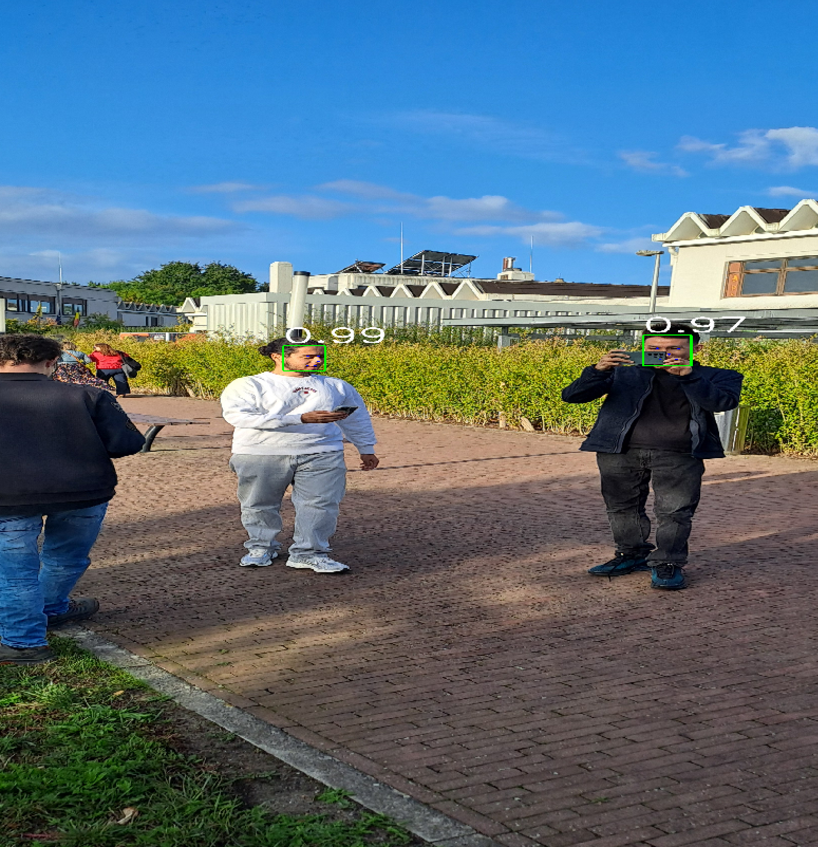
Detection
Images processed one by one
RetinaFace with ResNet-34 backbone
Bounding boxes and confidence scores visualized
Notes:
In the pipeline, each face is processed one by one by RetinaFace with the ResNet backbone. I chose ResNet-34 because it’s powerful enough to read all images and process them at the same time.

Slide 12
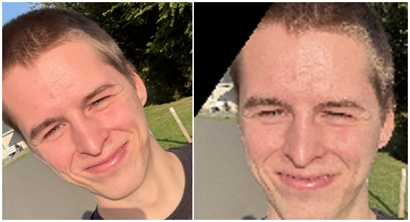
Face Alignment
Faces aligned & cropped
Corrects:
Rotation
Scale
Position
Produces standardized face format
Saved separately
Notes:
When a face is detected, I need to make sure they have the same standardised format. I can do this by aligning them. Alignment makes sure all faces have the right rotation, scale and position based on their landmarks. These aligned faces are saved separately for later use.

Slide 13
Embedding Generation
Notes:
Now I have aligned faces, I need numerical features to train models on face similarities.

Slide 14
Embedding model
Embedding = vector representation facial features
→ embeddings of same person close to each other
ArcFace (trained on angular margin loss)
Input: aligned face images
Output: embedding vectors
Notes:
An embedding is a vector representation of the facial features. This means that embeddings of faces of the same person should be close to each other in the vector space. To generate embeddings, I used ArcFace. It takes the aligned face and returns the embedding vector. ArcFace is trained on angular margin loss which means that the embeddings of the same person will point to same direction.

Slide 15
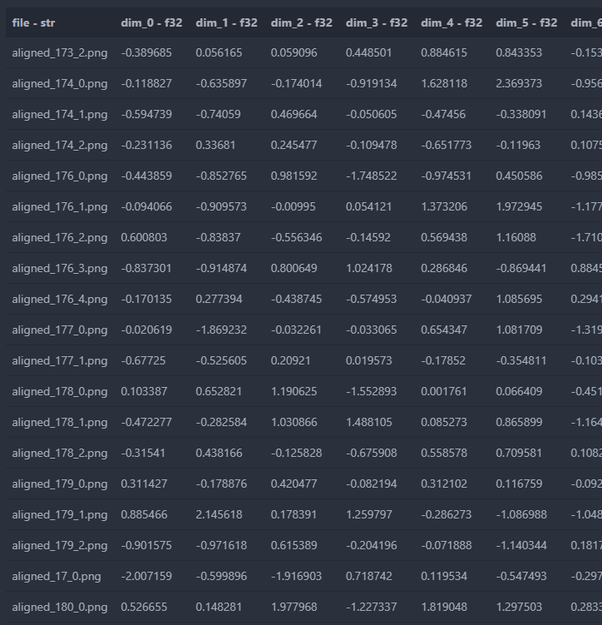
Metadata
Each embedding linked to a face filename
Notes:
These embeddings will be linked back to their aligned face in a separate file.

Slide 16
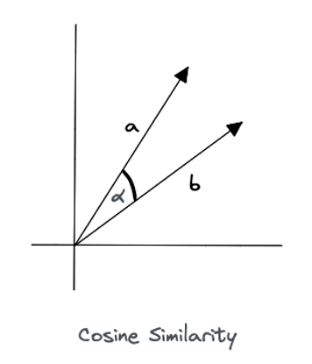
Cosine similarity
Measures angular similarity
Small angle = high similarity
vector direction encodes identity information
→ Classification
Notes:
A first way to compare embeddings is with cosine similarity, which is used by ArcFace and primarily by classification models since it measures identity similarity based on angular distance.

Slide 17
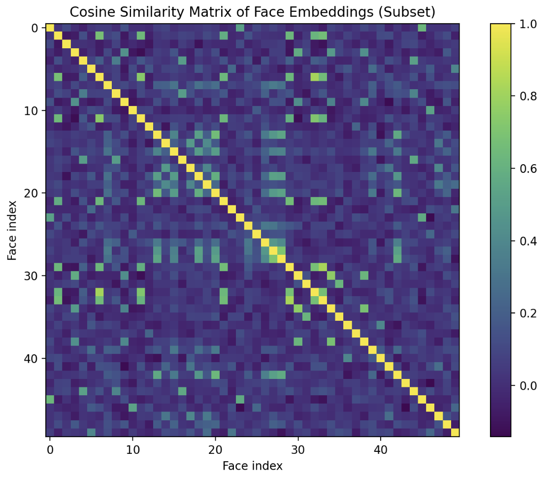
Notes:
In this confusion matrix, I calculated the cosine similarity between 2 faces and we can already see some structure.

Slide 18
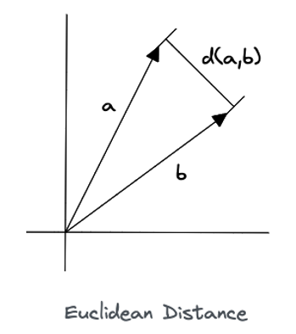
Euclidean Distance
Measures straight-line distance
→ Depends on magnitude and direction
Small distance = high similarity
Used in distance-based algorithms
→ Clustering
Notes:
A second way to compare embeddings is with Euclidean distance. Instead of using angular distance, it compares based on point-to-point distance and it’s mainly used for distance-based models like k-means clustering. This can be a problem because Euclidean distance depends on the magnitude and direction of the vector, so it doesn’t really reflect the identity of the face embedding.

Slide 19
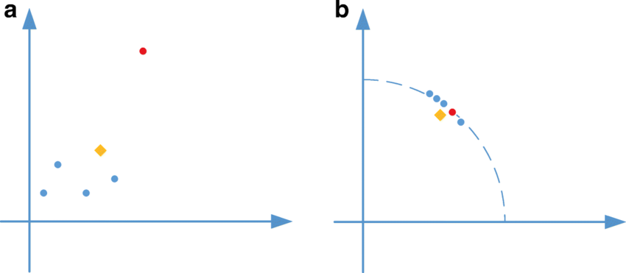
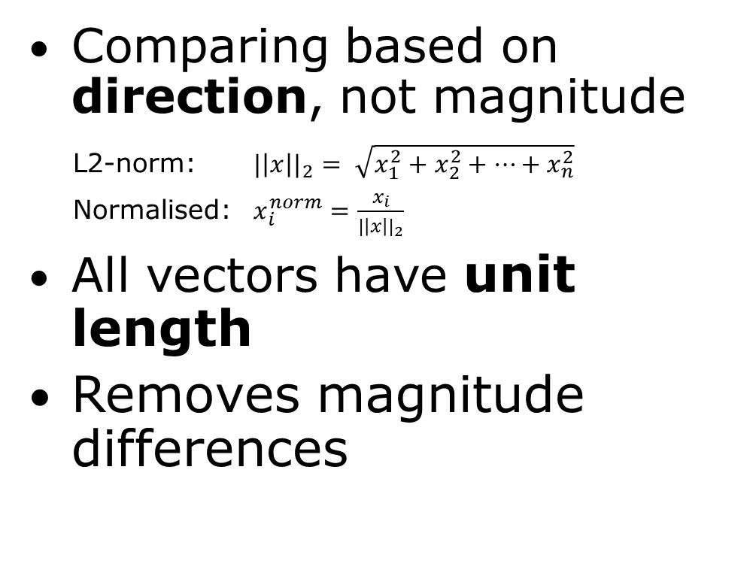
Embedding Normalization
Comparing based on direction, not magnitude
L2-norm: ${|\left|x\right||}_{2}= \sqrt{x_{1}^{2}+x_{2}^{2}+…+x_{n}^{2}}$
Normalised: $x_{i}^{norm}=\frac{x_{i}}{{|\left|x\right||}_{2}}$
All vectors have unit length
Removes magnitude differences
Notes:
To solve this, I need to normalize the embeddings so they all have unit length.

Slide 20
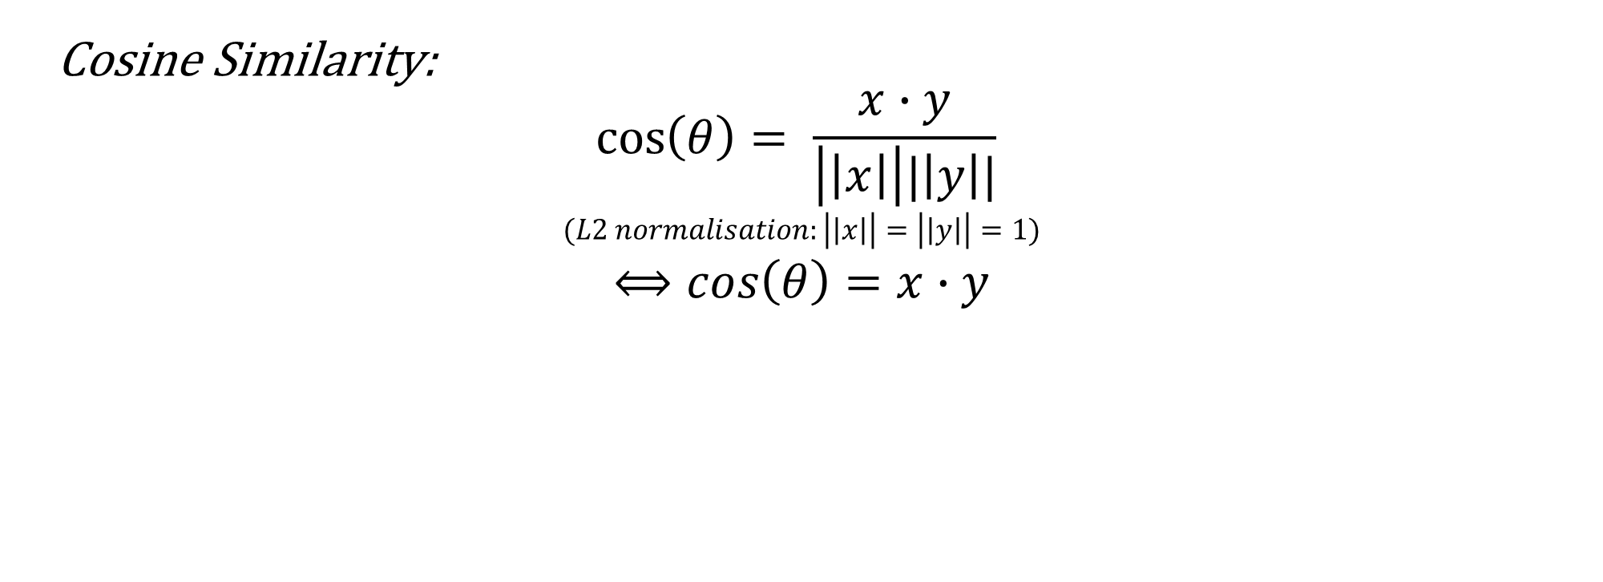
Cosine Similarity:
$$\cos\left(θ\right)= \frac{x∙y}{\left|\left|x\right|\right||\left|y\right||}$$
$$(L2 normalisation:\left|\left|x\right|\right|=\left|\left|y\right|\right|=1)$$
$$⟺cos\left(θ\right)=x∙y$$

Slide 21
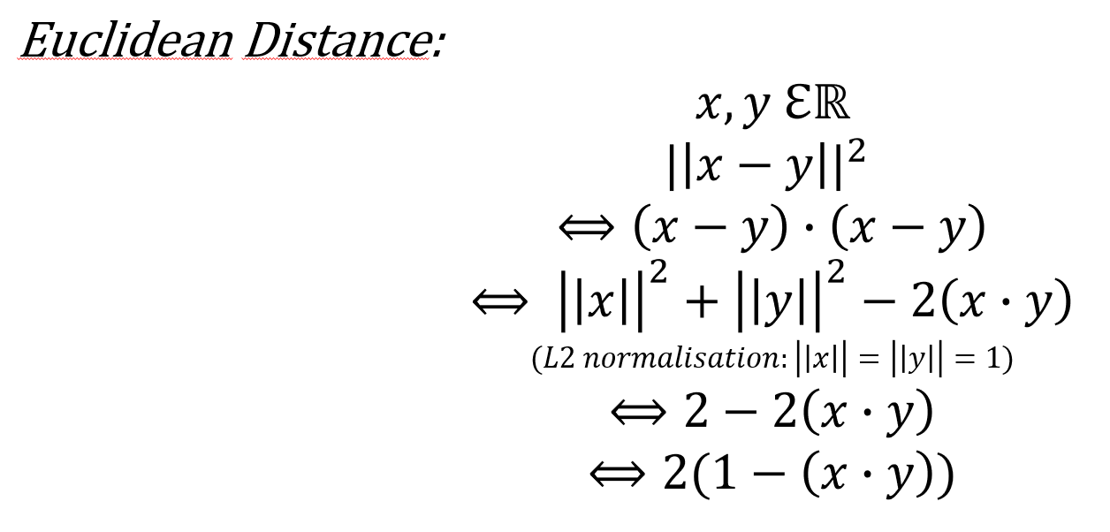
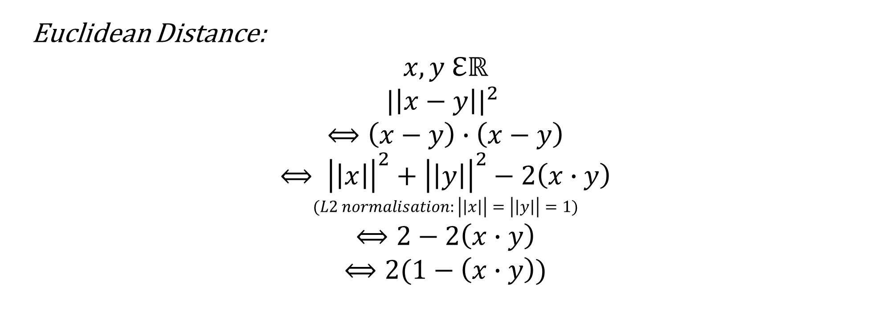
Euclidean Distance:
$$x,y ℇℝ$$
$${|\left|x−y\right||}^{2}$$
$$⟺\left(x−y\right)∙\left(x−y\right)$$
$$⟺ {\left|\left|x\right|\right|}^{2}+{\left|\left|y\right|\right|}^{2}−2\left(x∙y\right)$$
$$(L2 normalisation:\left|\left|x\right|\right|=\left|\left|y\right|\right|=1)$$
$$⟺2−2\left(x∙y\right)$$
$$⟺2(1−\left(x∙y\right))$$

Slide 22
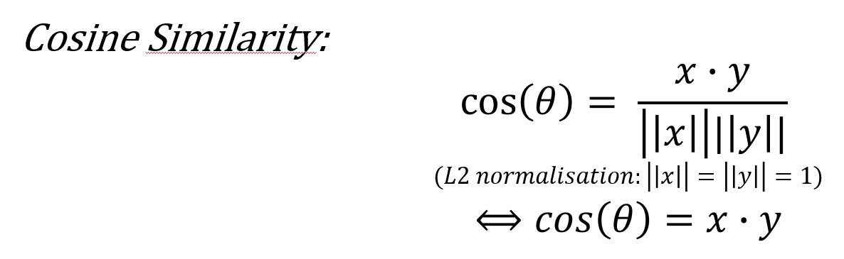

Slide 23
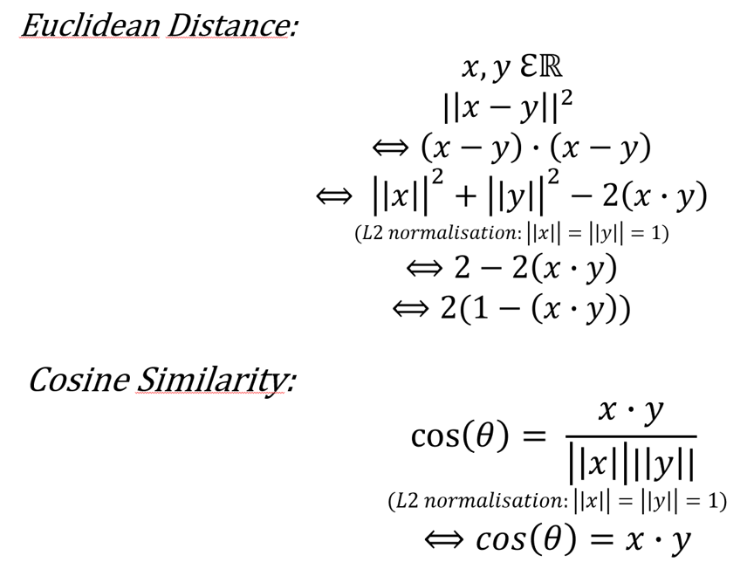
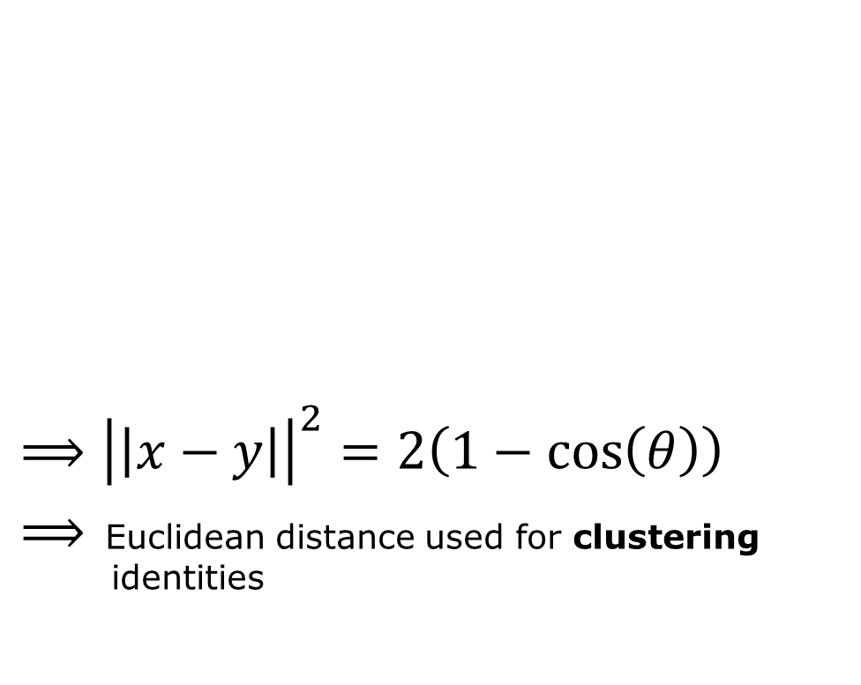
Euclidean distance in function of cosine similarity
$⟹{\left|\left|x−y\right|\right|}^{2}=2\left(1−\cos\left(θ\right)\right)$
$⟹$ Euclidean distance used for clustering aaaa identities
Notes:
After normalizing, we can see that Euclidean distance becomes dependent on the angular distance, which means it reflects the identity now and we can use it for clustering.

Slide 24
Selection of k
Notes:
Before I start clustering, I need to know how many clusters I need. Since we are a class of 12 people, I assume I need 12 clusters.

Slide 25
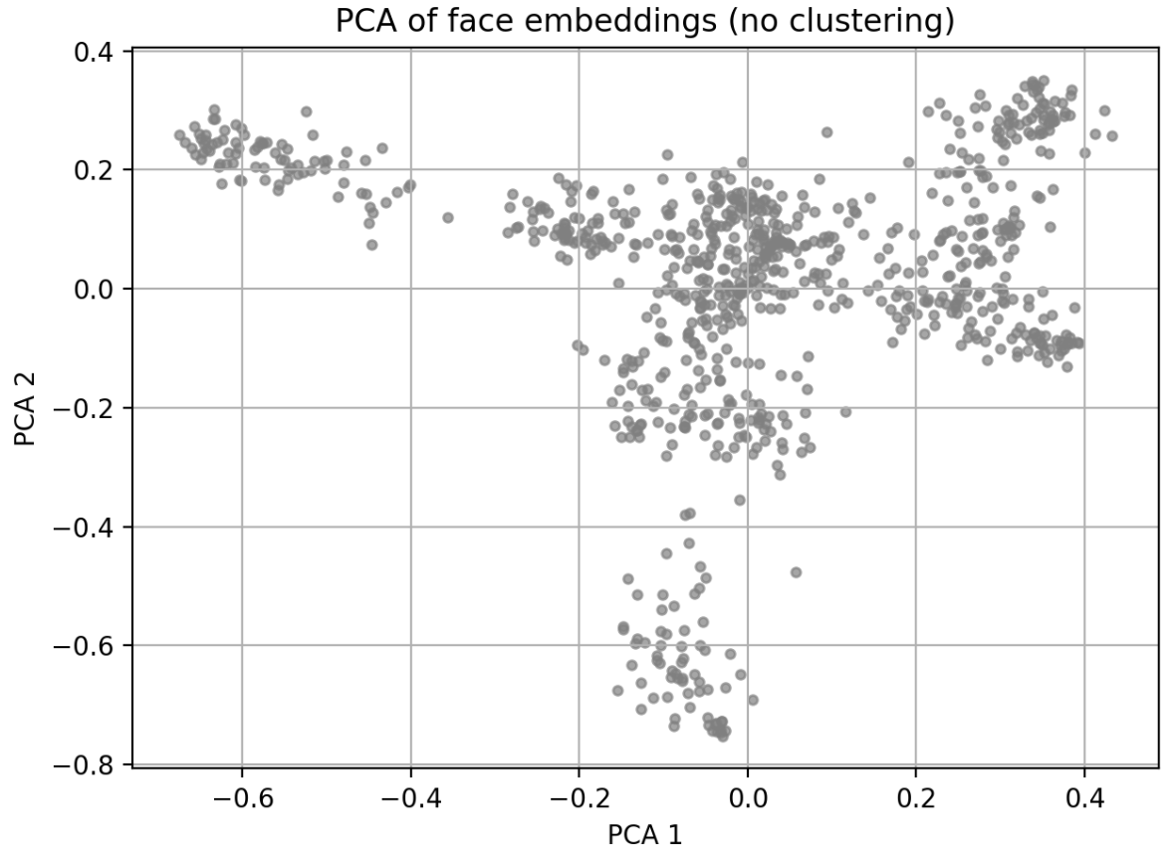
Notes:
Here we can see how all faces lie in the PCA space. We can already see that there are some clusters and structure.

Slide 26
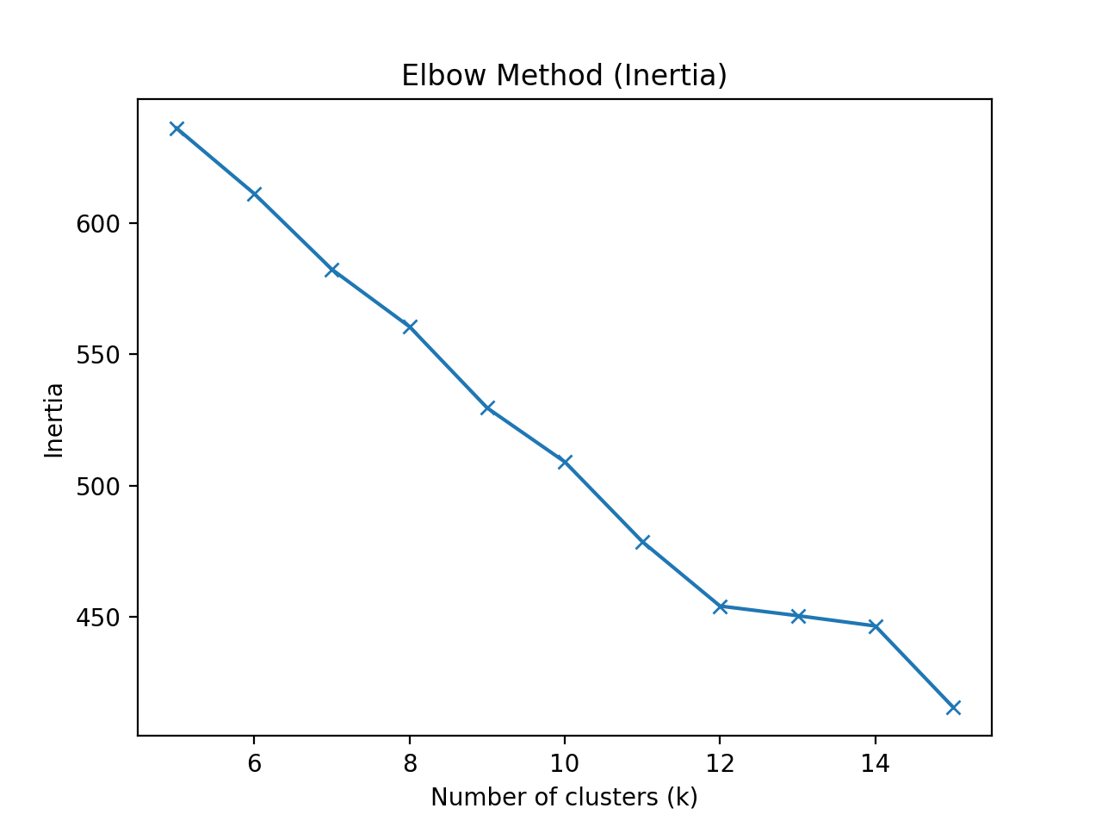
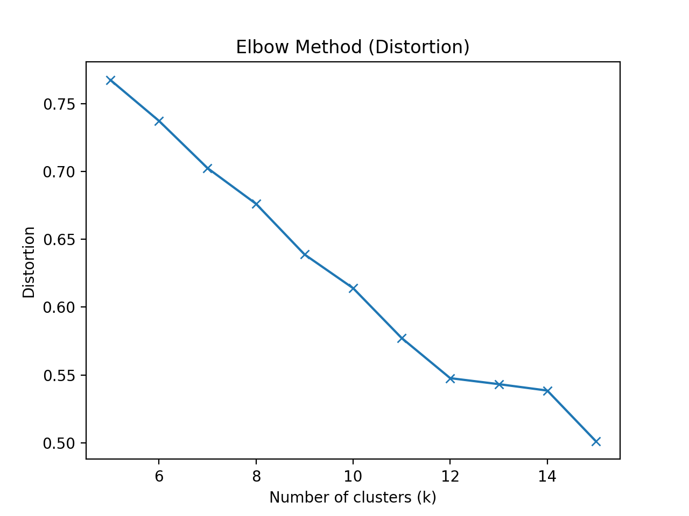
Elbow Method (Distortion)
Average squared distances between embeddings and their cluster
Lower distortion values = more compact clusters.
Notes:
A first method to decide the amount of clusters is with the elbow method for distortion. Distortion is the mean squared Euclidean distance from embeddings to their assigned cluster. The lower the distortion, the more compact. In the elbow we look for the elbow, which we can see is here on k = 13.

Slide 27
Elbow Method (Inertia)
Sum distance between embeddings and their centroids
Similar trend as distortion
Notes:
Inertia is the sum of distances between the embeddings and their cluster. Here we can also see that the elbow forms at k = 13.

Slide 28
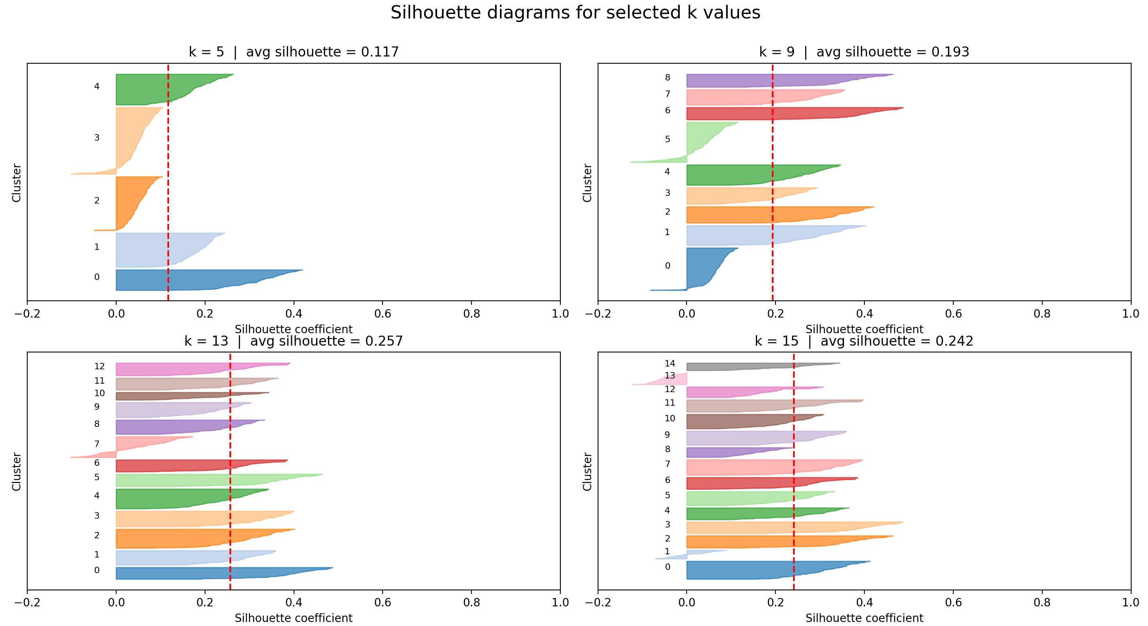
Silhouette scores
Measures cluster quality
Compares intra- vs inter-cluster similarity:
How close is point to assigned cluster?
How close is cluster to closest cluster?
Higher score = better quality
Notes:
A final method to decide this is with silhouette scores, which measure the cluster quality. It compares how close the datapoint is to its assigned cluster and how close it is to its closest other cluster. A score closer to 1 means better cluster quality. Here we can see again that the silhouette score is the highest for k = 13.

Slide 29
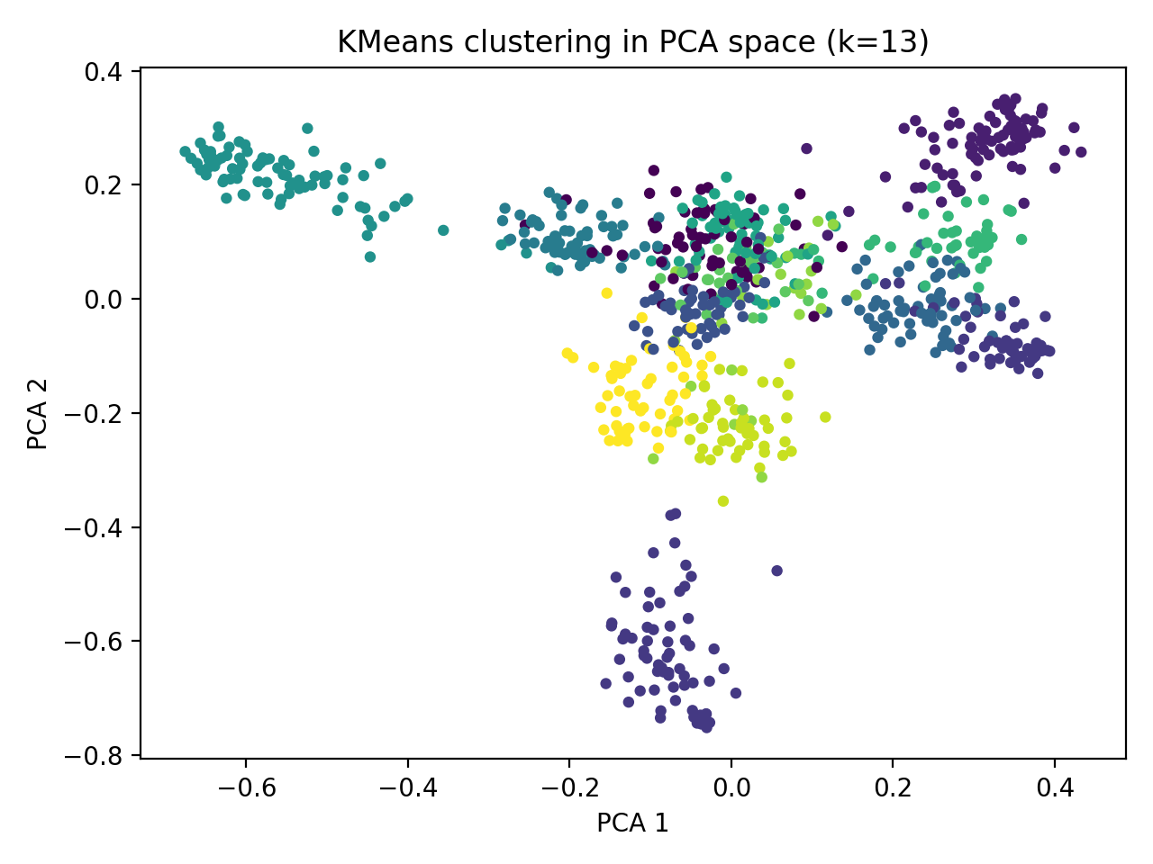
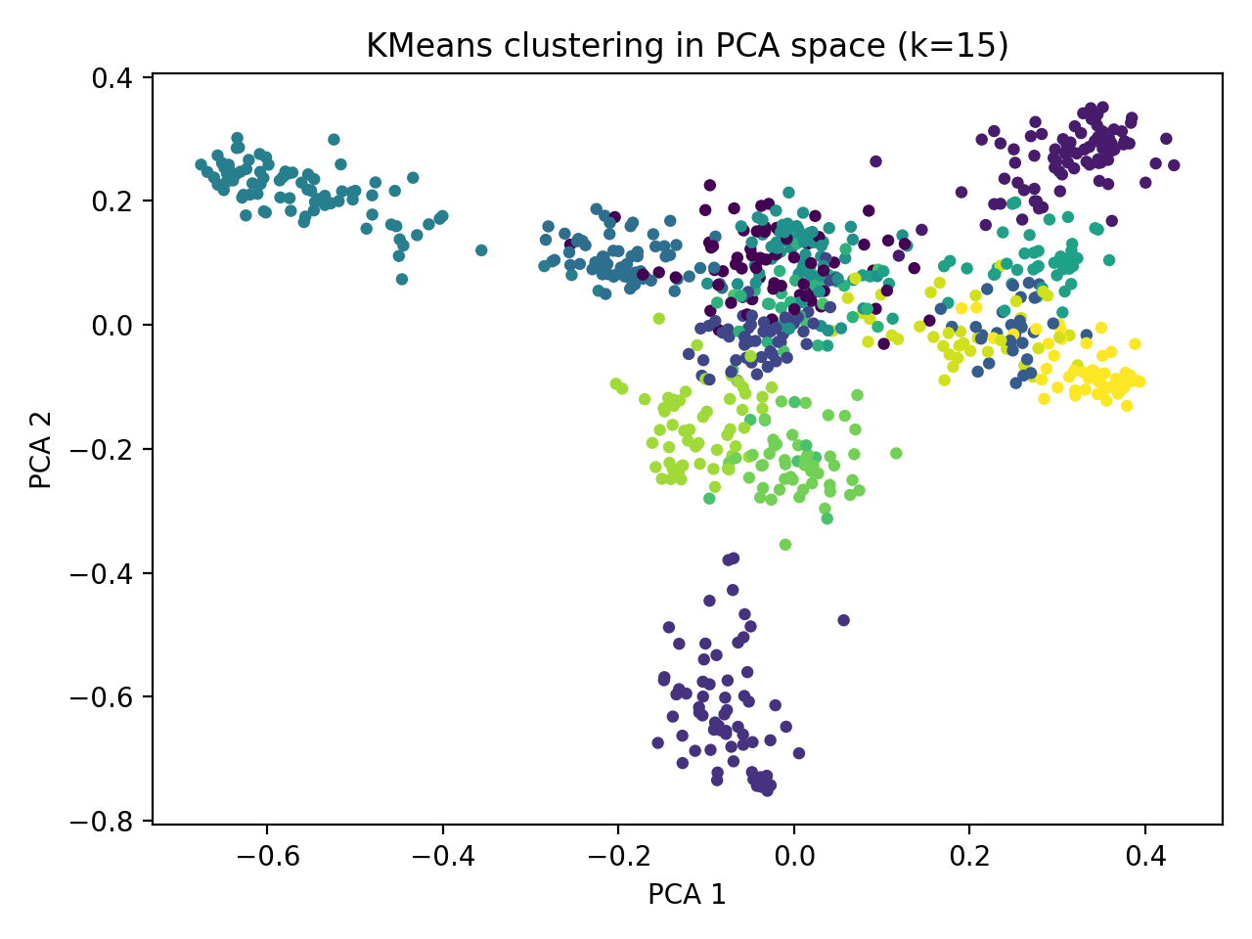
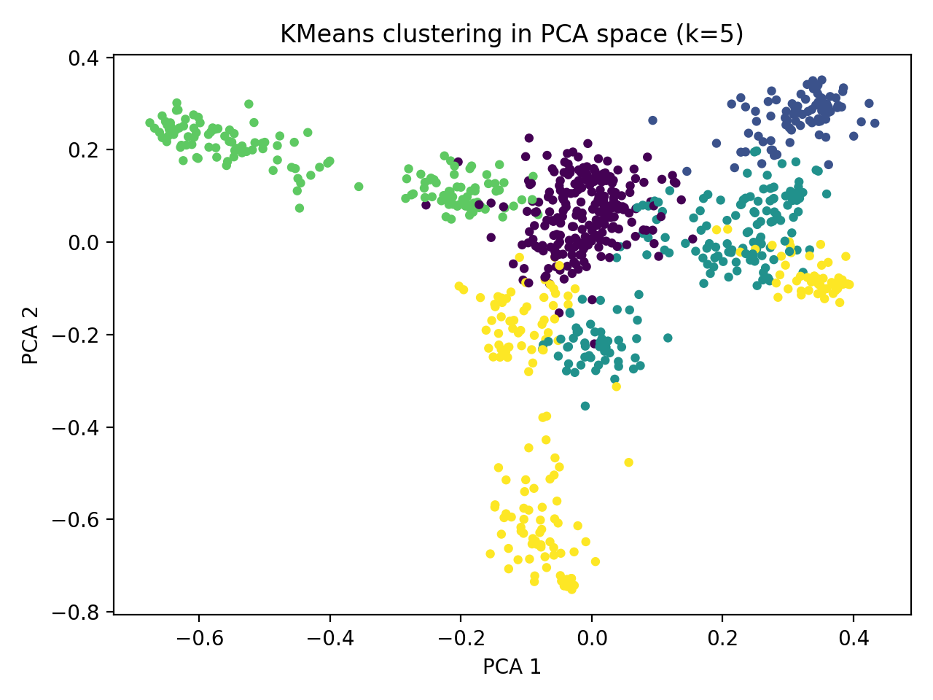

Slide 30
Clustering
Notes:
Since we now know how many clusters we need, we can start clustering the embeddings

Slide 31
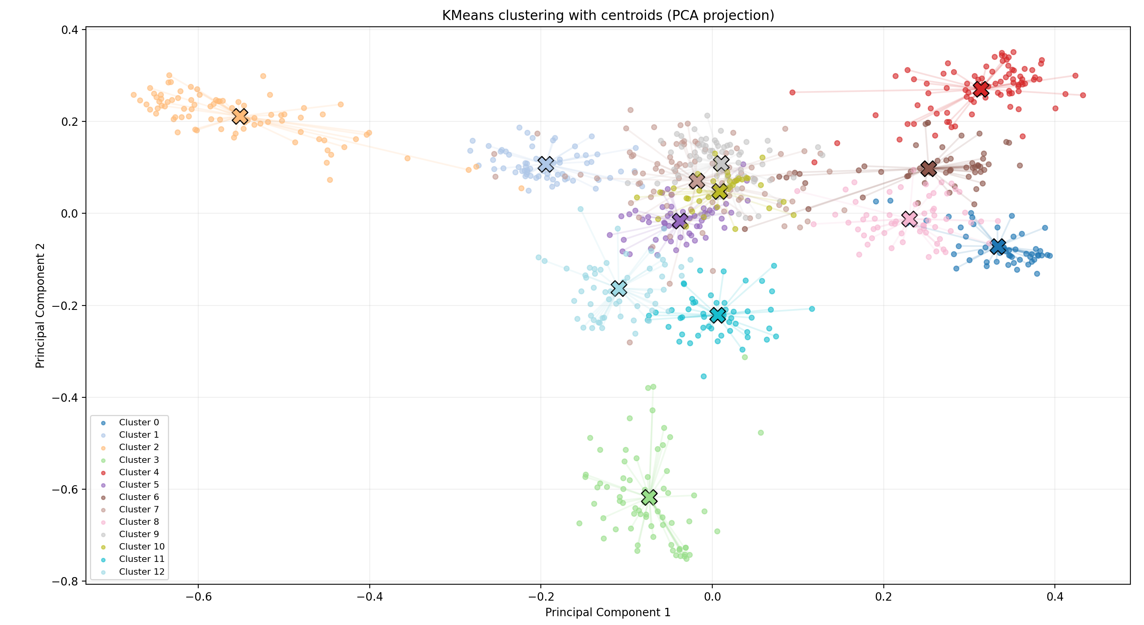
Kmeans clustering
Algorithm: Kmeans
Number of clusters: k = 13
Assigns embeddings to nearest centroid
Notes:
For clustering, I use k-means since it clusters based on Euclidean distance. Since we normalized the embeddings, Euclidean distance captures the identity similarities now. All embeddings are assigned to their nearest cluster.

Slide 32
Clustering workflow
Files column → list
Embedding column → list
2 lists: files[i] ↔ embeddings[i]
Kmeans predicts cluster label on embeddings list
→ 3 lists: files[i] ↔ embeddings[i] ↔ labels[i]
One folder created per cluster
Face copied to their cluster folder
Notes:
First, the column of the metadata containing the filenames is converted into a list, and the embedding values are converted into a separate list.
Because both lists originate from the same file and the order is preserved, each filename corresponds to exactly one embedding at the same index.
KMeans then predicts a cluster label for each embedding. Since the index remains the same, the cluster label can be directly linked to the corresponding filename.
As a result, each face image can be copied into the folder of its predicted cluster.

Slide 33
Model training

Slide 34
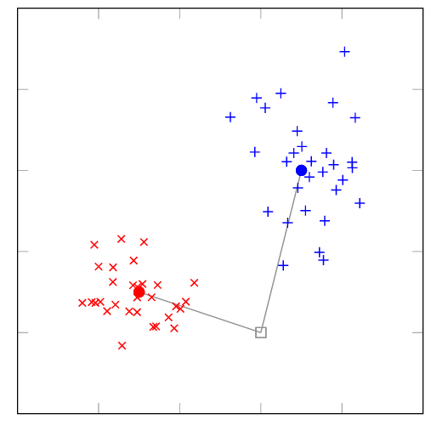
Centroid-based classifier
Centroid = mean embedding per identity
New embedding compared to centroid
→ closest centroid is selected
Notes:
The first model I trained is a centroid-based classifier. Here, the centroids are the mean of all embeddings of a cluster. When a new face is detected, its embedding is compared to all centroids and it’s assigned to the cluster of the closest centroid.

Slide 35
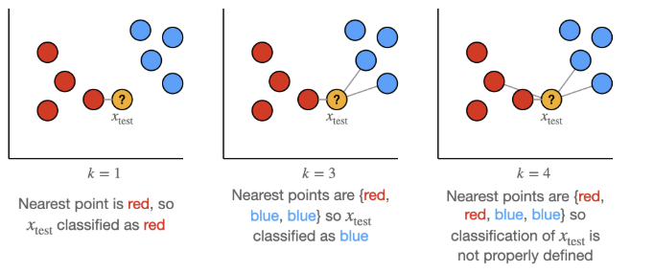
k-Nearest Neighbours
Compares embeddings
Prediction determined by votes
Notes:
KNN is similar, but instead of the closest centroid, it looks at the closest neighbours. It looks at the closest 3 neighbours, and the prediction is determined by the votes of the neighbours.

Slide 36
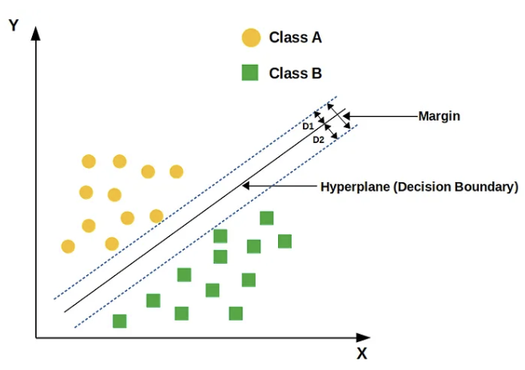
Support Vector Machine
Learns decision boundaries
Each class is separated by a hyperplane
Predicted identity = distance to the decision boundary and side
Notes:
The third model is a support vector machine, which will try to make boundaries between the datapoints. When a new face is detected, the prediction will depend on what side of the boundaries it’s placed on. The further from the boundary, the more confident it is.

Slide 37
Logistic Regression
Probabilistic classifier
→ estimates probability embedding belongs to each identity
→ highest probability = the final prediction
Notes:
The last model I used is logistic regression. Logistic regression estimates the probability that a face belongs to each identity. The final prediction is made by selecting the identity with the highest predicted probability.

Slide 38
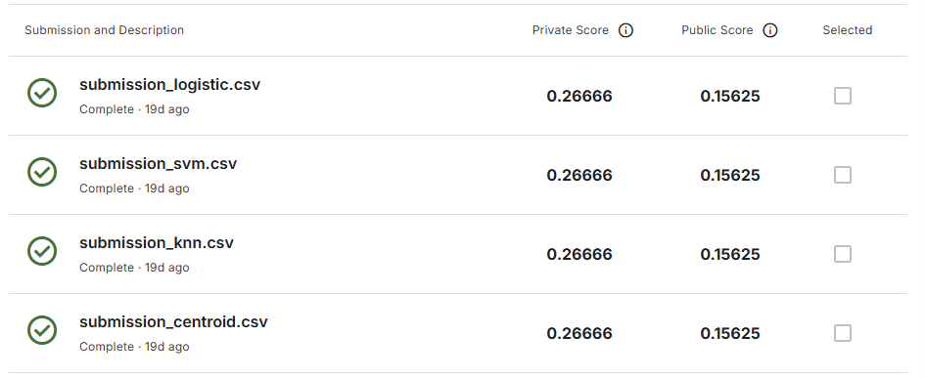

Slide 39
QUESTIONS?

